Slide 1
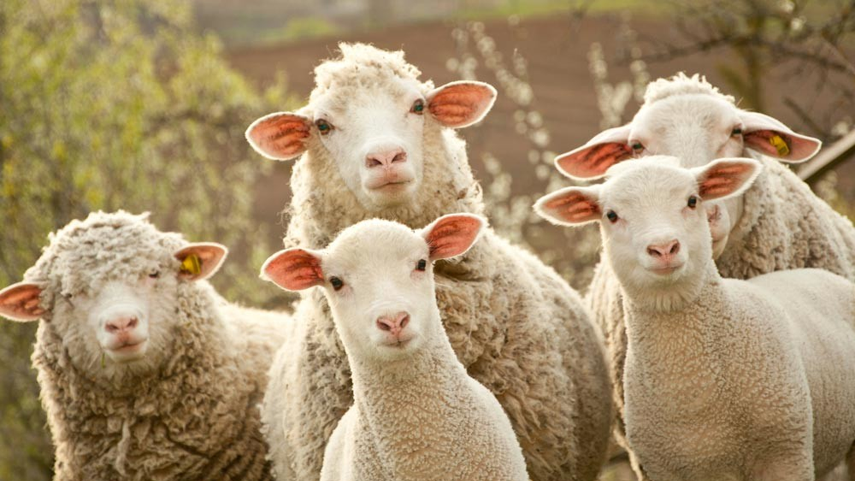
Saul’s Rebellion Against God’s Word 2
1 Samuel 15:12-23

Slide 2
Saul broke God’s heart too!
“it repenteth me that I have set up Saul to be king”
God regretted making Saul king not because God messed up, but because Saul did!

Slide 3
1 Timothy 1:12 And I thank Christ Jesus our Lord, who hath enabled me, for that he counted me faithful, putting me into the ministry;

Slide 4
1 Corinthians 4:1-2 Let a man so account of us, as of the ministers of Christ, and stewards of the mysteries of God. 2 Moreover it is required in stewards, that a man be found faithful.

Slide 5
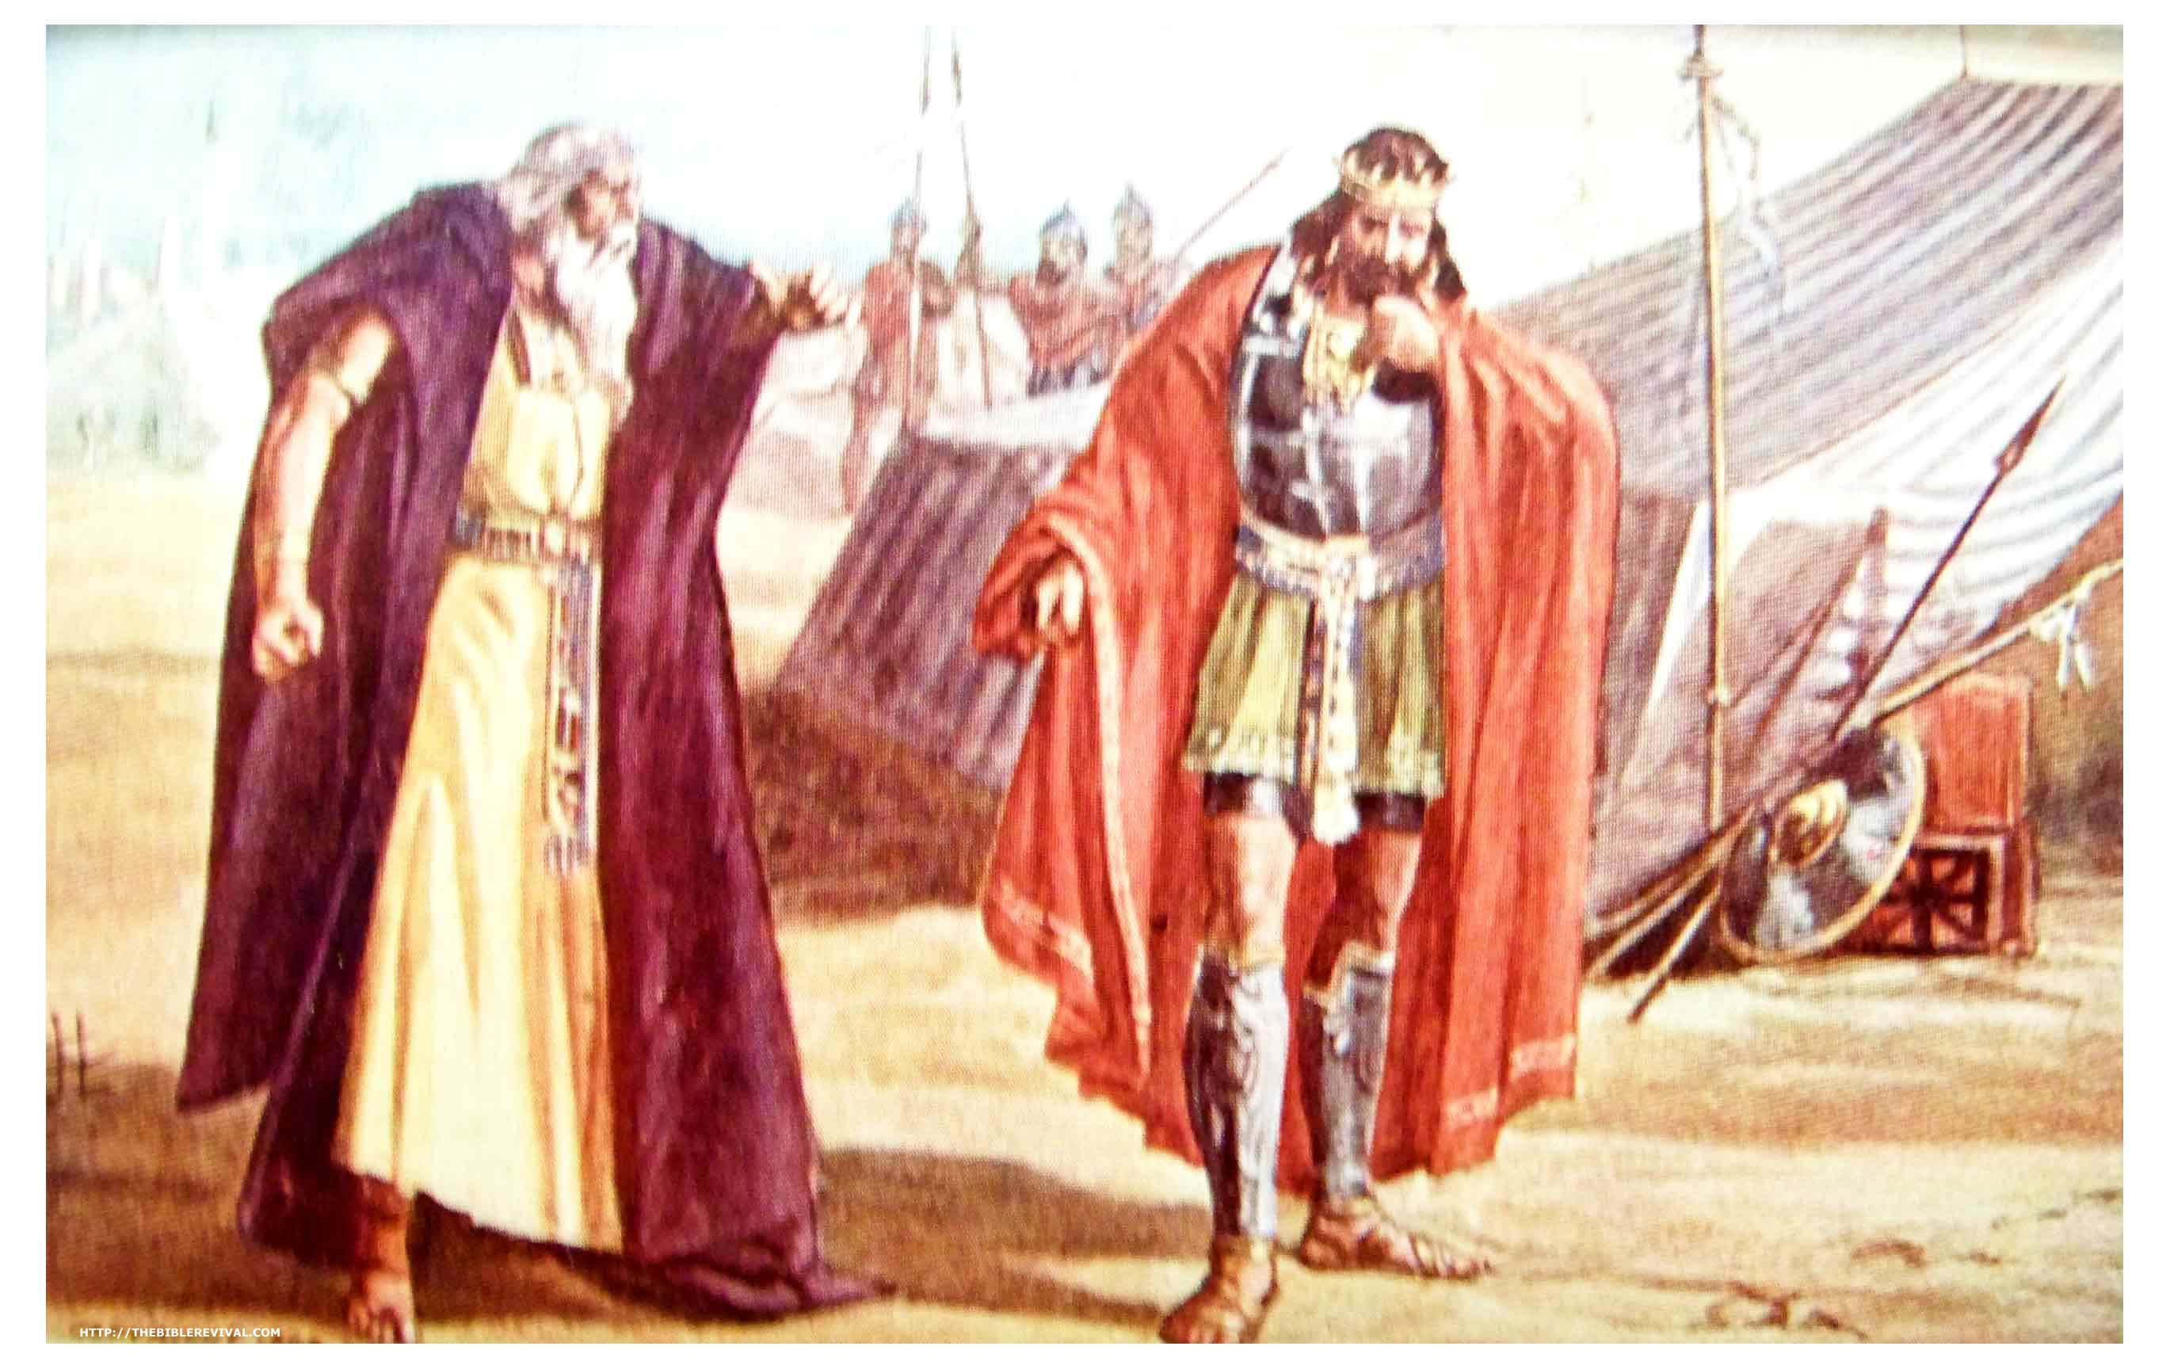
Saul’s lies to Samuel.
Saul sets up a monument of victory?
Saul has a great character flaw. Saying what is right instead of doing what is right!
Partial obedience to God is still rebellion.
13b “I have performed the commandment of the LORD.” No, Saul is a rebellious liar.

Slide 6
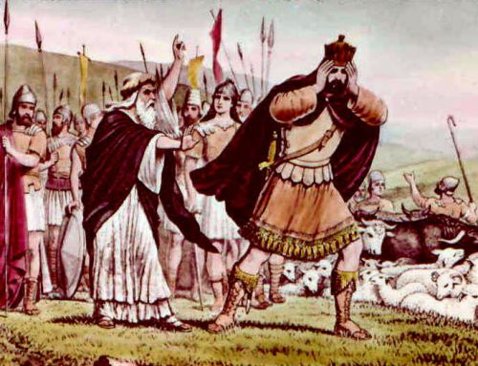
The evidence of sin.
Pay attention to Saul’s WORDS!
Instead of confession, self-justification.
Jehovah is Samuel’s, not Saul’s, God.
Saul is his own man.

Slide 7
The judgment of God.
“Stay” = cease! Or SHUT UP and listen. “Stop lying to me!”
This is a hard work for Samuel.

Slide 8
Ephesians 4:15 But speaking the truth in love, may grow up into him in all things, which is the head, even Christ:

Slide 9
The judgment of God.
“Stay” = cease! Or SHUT UP and listen. “Stop lying to me!”
This is a hard work for Samuel.
Counselors: we don’t give our opinions, we give the Word of God.
The goal is repentance and recovery!

Slide 10
2 Timothy 2:24-26 And the servant of the Lord must not strive; but be gentle unto all men, apt to teach, patient, 25 In meekness instructing those that oppose themselves; if God peradventure will give them repentance to the acknowledging of the truth; 26 And that they may recover themselves out of the snare of the devil, who are taken captive by him at his will.

Slide 11
The judgment of God.
Before, Saul was humble. Now he views himself as the ultimate authority.
Refusal to obey God aligns you with wickedness.
People don’t want to get caught. So they lie.
Saul has a great character flaw: Excuses instead of repentance.
Saul’s sin was always someone else’s fault!

Slide 12
Genesis 3:12-13 And the man said, The woman whom thou gavest to be with me, she gave me of the tree, and I did eat. 13 And the LORD God said unto the woman, What is this that thou hast done? And the woman said, The serpent beguiled me, and I did eat.

Slide 13
No one can make you sin.
The LORD wasn’t Saul’s God;
He was Samuel’s.
Saul was Saul’s god.
God doesn’t need our “donations.”

Slide 14
Psalm 50:7-15 Hear, O my people, and I will speak; O Israel, and I will testify against thee: I am God, even thy God. 8 I will not reprove thee for thy sacrifices or thy burnt offerings, to have been continually before me. 9 I will take no bullock out of thy house, nor he goats out of thy folds. 10 For every beast of the forest is mine, and the cattle upon a thousand hills.

Slide 15
Psalm 50:11 I know all the fowls of the mountains: and the wild beasts of the field are mine. 12 If I were hungry, I would not tell thee: for the world is mine, and the fulness thereof. 13 Will I eat the flesh of bulls, or drink the blood of goats? 14 Offer unto God thanksgiving; and pay thy vows unto the most High: 15 And call upon me in the day of trouble: I will deliver thee, and thou shalt glorify me.

Slide 16
The judgment of God.
Sacrificing to God is good, but obedience is always better because it means sacrificing ourselves to Him.
The sacrifices are worthless when the heart is in rebellion.

Slide 17
Isaiah 1:10-15 Hear the word of the LORD, ye rulers of Sodom; give ear unto the law of our God, ye people of Gomorrah. 11 To what purpose is the multitude of your sacrifices unto me? saith the LORD: I am full of the burnt offerings of rams, and the fat of fed beasts; and I delight not in the blood of bullocks, or of lambs, or of he goats. 12 When ye come to appear before me, who hath required this at your hand, to tread my courts?

Slide 18
Isaiah 1:13 Bring no more vain oblations; incense is an abomination unto me; the new moons and sabbaths, the calling of assemblies, I cannot away with; it is iniquity, even the solemn meeting. 14 Your new moons and your appointed feasts my soul hateth: they are a trouble unto me; I am weary to bear them. 15 And when ye spread forth your hands, I will hide mine eyes from you: yea, when ye make many prayers, I will not hear: your hands are full of blood.

Slide 19
Psalm 51:14-17 Deliver me from bloodguiltiness, O God, thou God of my salvation: and my tongue shall sing aloud of thy righteousness. 15 O Lord, open thou my lips; and my mouth shall shew forth thy praise. 16 For thou desirest not sacrifice; else would I give it: thou delightest not in burnt offering. 17 The sacrifices of God are a broken spirit: a broken and a contrite heart, O God, thou wilt not despise.

Slide 20
The judgment of God.
Witchcraft? Saul does it! Chpt 28.
Stubbornness = iniquity and idolatry.
It is sin and self-worship.

Slide 21
Isaiah 14:12-14 How art thou fallen from heaven, O Lucifer, son of the morning! how art thou cut down to the ground, which didst weaken the nations! 13 For thou hast said in thine heart, I will ascend into heaven, I will exalt my throne above the stars of God: I will sit also upon the mount of the congregation, in the sides of the north: 14 I will ascend above the heights of the clouds; I will be like the most High.

Slide 22
2 Corinthians 4:3-4 But if our gospel be hid, it is hid to them that are lost: 4 In whom the god of this world hath blinded the minds of them which believe not, lest the light of the glorious gospel of Christ, who is the image of God, should shine unto them.

Slide 23
John 8:44a Ye are of your father the devil, and the lusts of your father ye will do.

Slide 24
John 3:19-21 And this is the condemnation, that light is come into the world, and men loved darkness rather than light, because their deeds were evil. 20 For every one that doeth evil hateth the light, neither cometh to the light, lest his deeds should be reproved. 21 But he that doeth truth cometh to the light, that his deeds may be made manifest, that they are wrought in God.

Slide 25
2 Timothy 2:24-26 And the servant of the Lord must not strive; but be gentle unto all men, apt to teach, patient, 25 In meekness instructing those that oppose themselves; if God peradventure will give them repentance to the acknowledging of the truth; 26 And that they may recover themselves out of the snare of the devil, who are taken captive by him at his will.

Slide 26
Rejecting God’s Word results in God’s rejection in return.

Slide 27
Saul’s Rebellion Against God’s Word 2
1 Samuel 15:12-23

